Slide 1
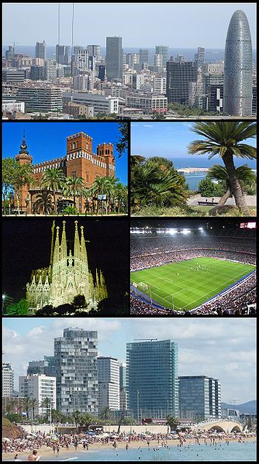
RG conference report
ACGT group meeting 23/11/11
by Yaron Orenstein
Some slides are from Yi Wang’s presentation at RG Recomb

Slide 2
Meta cluster 4.0
Mata-Cluster 4.0 was presented in the conference (Wang, Yi; Leung, H.; Chin, F.)
Meta-Cluster 3.0 was presented in Bioinformatics (April 2011) under the title:
A Robust and Accurate Binning Algorithm for Metagenomic Sequences with Arbitrary Species Abundance Ratio
By a group from the University of Hong Kong and Southeast University, Nanjing, China

Slide 3
Motivation
NGS is used to analyze the microbial environment in which we live
A critical step is to identify and taxonomically characterize the DNA fragments (reads or contigs) of a sampled of mixed species
Binning algorithms help in categorizing and assigning each read to its category (or bin)

Slide 4
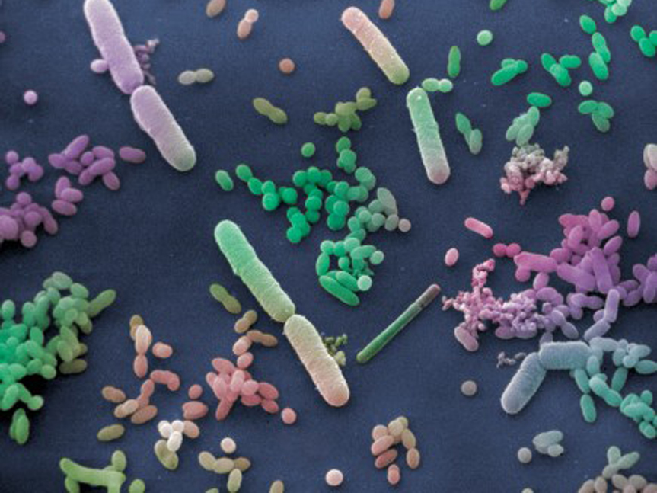
Metagenomics study
analysis of a collection of genomes of all microorganisms from an environmental sample
e.g. human guts, soil, dust from air conditioner
Importance
the study of diseases (e.g. Inflammatory Bowel Disease (IBD); gastrointestinal disturbance etc.)
The high throughput sequencing technologies
cheaper and faster to get DNA fragments from multiple species in such a mixed sample
accelerate the study of metagenomics

Slide 5
Introduction
Genomic analysis on the collective genomes of all microorganisms from an environmental sample becomes essential
DNA fragments of a metagenomics project are usually from multiple genomes and most of the genome sequences are unknown
There is a need to group DNA fragments from similar species together

Slide 6
Binning of Metagenomic data
Bacteria 1
Bacteria 2
Bacteria 3
……
Bacteria n
sample
Sequencing
Bacteria 1
Bacteria 2
Bacteria 3
Bacteria n
Binning

Slide 7
Previous methods
Traditional binning methods are classified to:
1. Similarity-based (Huson et al. 07):
Align each DNA fragment to known reference genomes. Con: requires a sequenced genome
2. Composition-based (Chan et al. 08):
Group DNA fragments in a supervised or semi-supervised manner using generic features such as genome structure or composition. Cons: low availability and reliability of taxonomic markers
Examples for markers: 16S rRNA, recA and rpoB

Slide 8
Improved previous methods
Unsupervised binning algorithms based on the occurrence frquencies of l-mers
L-mer distributions of the fragments in the same genome are more similar than of two unrelated species
Many algorithms use this property: TETRA (Teeling et al. 04), MetaCluster (09), MetaCluster 2.0 (10) and LikelyBin (Kislyuk et al. 09)
AbundanceBin (Wu et al. 10) is aimed to handle unknown number of species and unbalanced ratios

Slide 9
MetaCluster 3.0
An integrated binning algorithm based on two phases:
1. Top-down clustering: separate fragments into small groups with similar sizes and try to guarantee that the majority belongs to the same species
2. Bottom-up merging: try to combine clusters with the same species together
MetaCluster 3.0 aims to
1. Determine automatically the number of different species in the sample
2. Classify accurately the metagenomic fragments with balanced species abundance ratios

Slide 10
The pipeline of MetaCluster 3.0 is divided into two major phases: top–down clustering and Bottom–up merging.
Leung H C M et al. Bioinformatics 2011;27:1489-1495
© The Author 2011. Published by Oxford University Press. All rights reserved. For Permissions, please email: journals.permissions@oup.com
Notes:
The pipeline of MetaCluster 3.0 is divided into two major phases: top–down clustering and Bottom–up merging.

Slide 11
Observations
The 2-phase strategy is based on:
1. The difference between two l-mer distributions of fragments from the same species follows a normal distribution
2. The differences between two l-mer distributions of fragments from different species also follows a normal distribution
This allows to derive a probabilistic model to determine how many clusters should be used

Slide 12
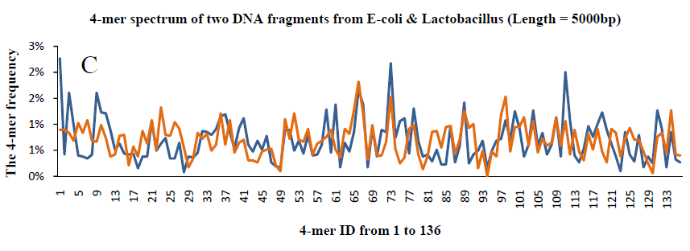
MetaCluster 2.0 and 3.0
Observation 1:
Similar species have similar 4-mer frequency distribution
Pattern Freq
AAAA 10
AAAC 5
….. …..
4-mers spectrum of 2 DNA fragments from 2 E-coli genomes
4-mers spectrum of 2 DNA fragments from E-coli & Lactobacillus
Each DNA fragment is represented by a vector.
Similarity of two vectors: Spearman Footrule Distance

Slide 13
L-mer frequency distribution and distance definition
The feature vector includes all possible l-mers (reverse complements are the same)
N(l) = (4^{l} + 4^{l/2})/2 if l is even
N(l) = (4^{l})/2 if l is odd
For l=4, N(l) = 136
The difference of two l-mer distributions from two fragments is calculated using the Spearman Footrule distance between their corresponding l-mer feature vectors

Slide 14
Spearman Footrule distance
Two 4-mer feature vectors A={a_{i}} and B={b_{i}}
Let r^{A}(a_{i}) and r^{B}(b_{i}) be the rank of a_{i} and b_{i} in the sorted list of {a_{i}} and {b_{i}}, respectively
Dist (A,B) = ∑ | r^{A}(a_{i}) - r^{B}(b_{i}) |
The distance range is between 0 to k(k+1), where 0 is similar vectors

Slide 15
Spearman distance distribution
Randomly select:
For each genome out of 10,000:
1 million pairs of fragments of 1,000 nt long
For fragments from different families, select:
10,000 pairs of genomes (the two genomes belong to different families):
One fragment of length 1,000 nt from each genome
This is repeated for 10⁶ pairs of fragments

Slide 16
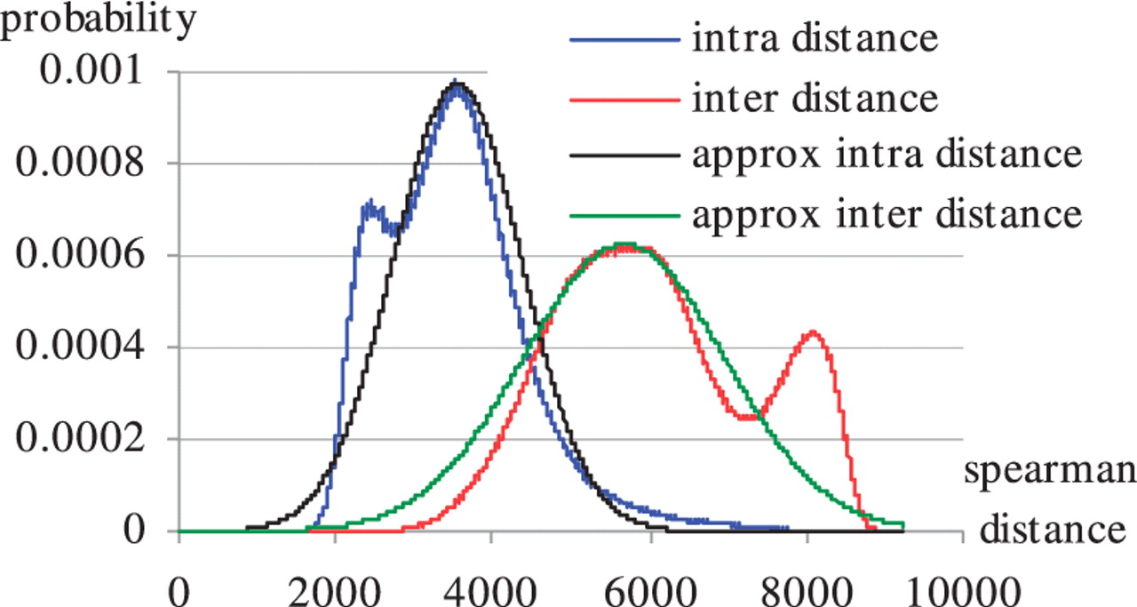
Probability density functions of the Spearman distance between two fragments from the same species (intradistance) and between two fragments from the same order but different families (interdistance).
Leung H C M et al. Bioinformatics 2011;27:1489-1495
© The Author 2011. Published by Oxford University Press. All rights reserved. For Permissions, please email: journals.permissions@oup.com
Notes:
Probability density functions of the Spearman distance between two fragments from the same species (intradistance) and between two fragments from the same order but different families (interdistance). Approx intradistance and approx interdistance is the normal distribution approximation of the two distances.

Slide 17
Phase 1: Two-down clustering
Apply the k-median algorithm to cluster the fragments into k’ clusters of similar sizes
K-median algorithm repeatedly assigns feature vector to the closest cluster and selects a feature vector in each cluster as the center with the following objective function:
Feature vector c_{i} is the center of cluster C_{i}

Slide 18
Top-down clustering cont.
The algorithm is repeated several times with different initial clustering centers and the one that gives the minimum objective function is selected
The value of k’ is determined automatically based on a probabilistic model by restricting the number of false positive fragments in a cluster to be limited by some predefined threshold t x size of the cluster

Slide 19
How to determine k’
Average cluster size is n/k’
The distance between each fragment and the center from the same species can be approximated by N(μ_{intra}, σ²_{intra})
The distance from different species can be approximated by N(μ_{inter}, σ²_{inter})
Given a cluster C_{i}, the total distance between the center c_{i} and each feature vector in the cluster d_{i} = ∑_{AЄCi} dist(A, c_{i})

Slide 20
How to determine k’ – cont. 1
Let s out of n/k’ fragments in the cluster be sampled from the same species with average distance between the center and the rest s-1 fragments being x
The probability that there are n/k’ – s false positives equals the probability that the average distance between the center and the n/k’ – s fragments from different segments will be (d_{i}-(s-1)x)/(n/k’-s)
This follows the Gaussian distribution N(μ_{inter}, σ²_{inter}/(n/k’-s))

Slide 21
How to determine k’ – cont. 2
The expected number of false positives in a cluster:
Where .
MetaCluster increases the value of k’ until the expected number of false positives in a cluster ≤ t * (n/k’)

Slide 22
Bottom-up merging of the clusters
The inter-cluster distances between pairs of DNA fragments A in C₁ and B in C₂:
When k is known, merging is performed between closest cluster till k clusters are left

Slide 23
Bottom-up continued
Two cluster C₁ and C₂ with average intra-cluster d₁ and d₂ respectively are merged if α∙dist(C₁,C₂)≤average(d₁,d₂).
α is determined by minimizing the expected false negative and false positive fragments
Assume all fragments in C_{i} are sampled from the same species, the intra-cluster distance can be modeled by the intra-species distance distribution

Slide 24
Determining α
The probability that two clusters are not merged incorrectly (false negative):
The probability to incorrectly merge two cluster (false positive):

Slide 25
MetaCluster 4.0
Limitations of MetaCluster 3.0:
Can only work for long reads, say 500bp
Fails when number of species is large, say >20 (accumulated errors in the merging step)
MetaCluster 4.0 was developed to handle:
Lack of reference genome (99% species not known)
Uneven abundance ratio of species (1:100 or higher)
Short NGS reads (50-100 bp)
A large number of species (can be more than a hundred, even thousands)

Slide 26
MetaCluster 4.0 overview
Form groups of short reads likely from the same genome
Estimate the l-mer distribution of each group
Employ a modified version of MetaCluster 3.0 to bin the groups based on their l-mer distributions

Slide 27
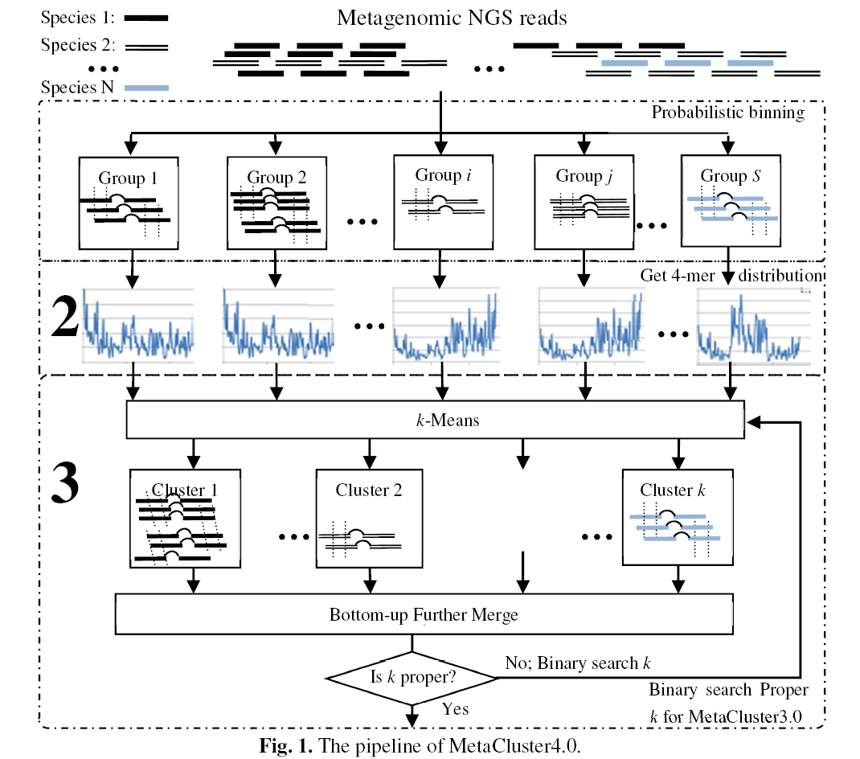
1

Slide 28
Phase 1: probabilistic grouping
Each read is considered as a group and are progressively merged as long as
A read in one group shares a common w-mer with a read in another group
The likelihood of an incorrect false-positive merging is low (below a threshold p) [= a limit on the size of the groups]
When w≥35 the probability of two reads from different genomes to share a w-mer is <0.03% and < 0.22% if they are from the same family or genus level, respectively

Slide 29
Observation 2: Reads from different genomes seldom share a “long” common w-mer
Percentage

Slide 30
Outcomes of Phase 1
Each group of reads is equivalent to an 8k contig (solve the problem of short reads)
Similar number of groups from each species
(number of reads in each group might vary a lot)
For example:
Two species with abundance ratios 1 : 50
Ratio of the number of groups is 1 : 3 only
(solve the problems of uneven abundance ratio)

Slide 31
Diminishing the effect of uneven abundance ratios
Each group is a set of virtual contigs
There is an implicit upper bound on the size of each group (due to false positive probability)
As long as the coverage is good enough, each species has more or less the same number of groups, regardless of its abundance ratio
This is critical to handle a large number of species with varying abundance ratios

Slide 32
Phase 2: 4-mer distribution estimation
Extract a set of “correct” r-mers from the reads that are likely to be on the genome
The r-mer should occur at least t times to avoid false positives, but r shouldn’t be too long to avoid false negative
[calculation of r and t skipped]
r=16 in the implementation
Estimate l-mer distribution by adding up the l-mer distributions of these correct r-mers

Slide 33
Binning: modified MetaCluster 3.0
MetaCluster 3.0 is iteratively used as a tool to accurately estimate the number of species
K (number of species) is searched in a binary manner
To decide if the proper k was found, …

Slide 34
Phase 3: Binning
Use MetaCluster 3.0 to estimate the number of species by binary search
k > number of species: with merging step
k ≤ number of species: without merging step
Use MetaCluster 3.0 to bin (with k=# species)
Similar number of groups for each species (no problem of uneven abundance ratios)
Do not need merging step
Does not accumulate errors in merging step
Solves the problem of huge number of species

Slide 35
Experiments and results
AbundanceBin is the only available tool that can work on short reads
All simulated data are generated based on the genomes in NCBI database

Slide 36
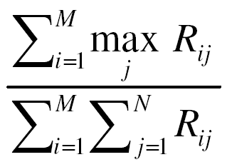
Performance evaluation
N genomes, M clusters C_{i} (1 ≤ i ≤ M), R_{ij} = num. of reads from genome j in cluster i
Precision:
Sensitivity:

Slide 37
Simulated Data
Randomly picked
length-75 pair-end reads
1% sequencing error
250±50 bp insert distance
coverage = 15 × the abundance ratio
Six datasets each with 20 species were generated, with three for the family-genus level (FG) (1a-1c) and three for the genus-species level (GS) (2a-2c)
Extreme cases (3a-3c)

Slide 38
Comparison with AbundanceBin with datasets of 20 species
Six datasets each with 20 species were generated, with three for the family-genus level (FG) (1a-1c) and three for the genus-species level (GS) (2a-2c)
Extreme cases (3a-3c)

Slide 39
Dataset
Dataset | # of groups | # of species | #. of species in each group | Abundance Ratios
1a | 6 families | 20 | 1,3,3,3,4,6 | 1:1:1:1:1:1:1:1:1:1:1:2:2:2:3:3:3:4:4:4
1b | 5 families | 20 | 1,2,3,4,10 | 1:1:1:1:1:1:1:1:1:1:1:2:2:2:3:3:3:4:4:4
1c | 5 families | 20 | 1,5,4,4,6 | 1:1:.:1:4:4:.:4:6:6:.:6:8:8:.:8:10:10: :10
2a | 4 genera | 20 | 5,5,7,3 | 1:1:1:1:1:1:1:1:1:1:1:2:2:2:3:3:3:4:4:4
2b | 4 genera | 20 | 4,6,4,6 | 1:1:1:1:1:1:1:1:1:1:1:2:2:2:3:3:3:4:4:4
2c | 4 genera | 20 | 2,6,3,9 | 1:1:1:1:1:4:4:4:4:4:6:6:6:6:6:8:8:8:8:8
Higher taxonomic level: easy
Lower taxonomic level: difficult

Slide 40
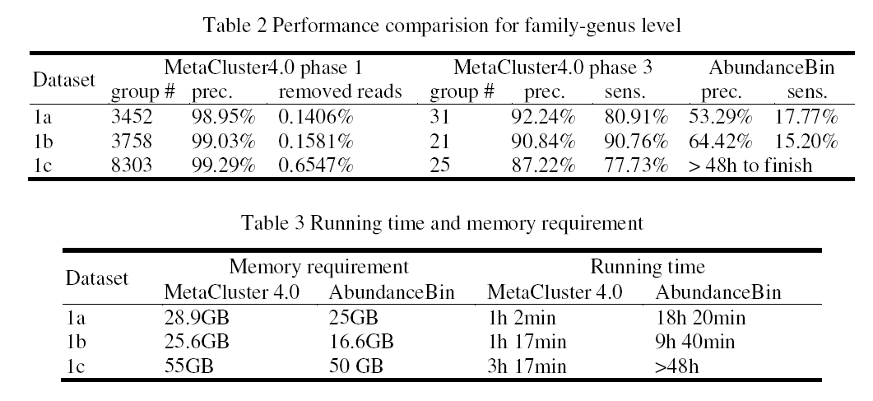
Family-genus level

Slide 41
Genus-genus level

Slide 42
Binning Results for Different Dataset
Dataset | #. of groups | Precision | Sensitivity | Space cost | Time cost
1a | 31 | 92.24% | 80.91% | 28.9GB | 1h 2min
1b | 21 | 90.84% | 90.76% | 25.6GB | 1h 17min
1c | 25 | 87.22% | 77.73% | 55GB | 3h 17min
Dataset | #. of groups | Precision | Sensitivity | Space cost | Time cost
2a | 26 | 86.67% | 79.83% | 19.9GB | 1h 8min
2b | 23 | 90.87% | 88.26% | 23.0GB | 1h 10min
2c | 19 | 80.71% | 86.48% | 53.0GB | 2h 51min

Slide 43
Extreme Cases
Dataset | # of groups | # of species | #. of species in each group | Abundance Ratio
3a | 18 genera | 100 | 3,4×7,5×3,6×2,7×2,9×2,10 | Equal abundance ratio
3b | 1 genus | 7 | 7 | 1 : 2 : 4 : 8 : 16 : 32 : 64
3c | 7 genera | 50 | 5,6,6,7,7,9,10 | (1 : 1.5 : 2 : 2.5 : 3 ) × 10
Dataset | #. of groups | Precision | Sensitivity | Space cost | Time cost
3a | 113 | 80.02% | 85.41% | 66GB | 4h16min
3b | 9 | 91.08% | 84.73% | 54GB | 30h
3c | 51 | 80.29% | 85.79% | 50GB | 3h51min

Slide 44
Real Biological Dataset
Qin et al. (Nature, 2010)
Performed a deep sequencing on samples from feces of 124 European adults
Reads length varied from 44 bp to 80 bp
Three selected datasets were merged
Read length ~75 bp
23M pair-end reads
Contain reads from 10 species
Filtering reads from species with low abundance ratios
BLAST was used to map reads to the ten reference genomes and allow up to 5% mismatch

Slide 45
Experimental Results
Groups | Precision | #. of reads | Major Species | % of reads from same genus
1 | 97% | 2.98M | Bacteroides sp. 2_1_7 | 99.1
2 | 77% | 2.84M | Bacteroides uniformis | 97.6
3 | 45% | 0.54M | Bacteroides uniformis | 57.8
4 | 76% | 0.76M | Ruminococcus bromii L2-63 | 88.3
5 | 78% | 0.58M | Clostridium sp. SS2-1 | 77.6
6 | 68% | 1.06M | Bacteroides thetaiotaomicron VPI-5482 | 99.4
7 | 68% | 1.56M | Parabacteroides merdae | 68.5
8 | 98% | 0.74M | Alistipes putredinis | 98.1
9 | 90% | 0.92M | Alistipes putredinis | 90.5
10 | 68% | 0.76M | Parabacteroides merdae | 68.1
11 | 66% | 10.2M | Bacteroides vulgatus ATCC 8482 | 97.6
11 groups are reported in the sample
MetaCluster 4.0 fails to detect two species

Slide 46
Simulated data
Given an abundance ratio for a species with known genome in NCBI, a set of length-75 pair-end reads was picked from the genome with 1% sequencing error and 250±50bp insert distance with coverage 15xabundance ratio
Minimum coverage of 15 is assumed

Slide 47
Experiments on real biological data
Three human feces samples with pair-end read with length around 75bp were picked and combined together to construct a dataset with 23M pair-end reads (Qin et al. 10)
Reads not from the most abundant ten species were filtered out
BLAST was used to map reads to the ten reference genomes and allow 5% mismatch

Slide 48
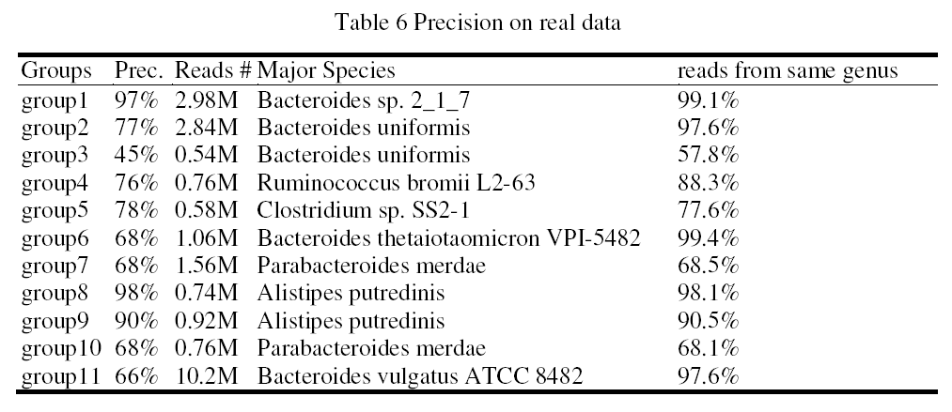
11 groups are reported in the sample
Metaclust4 fails to detect two species

Slide 49
Summary
Binning metagenomics reads is a crucial step in metagenomic analysis
MetaCluster 4.0 is an unsupervised binning algorithm for short reads, that can deal with:
Short reads without any prior knowledge
Determining the number of genomes auto.
Determining the number of genomes auto.
Performing well even with more than 20 genomes
No assumption on phylogenetic levels

